Slide 1
Defines DBMS schemas at three levels:
  Internal schema at the internal level to describe physical storage structures and access paths (e.g indexes). (physical level)
    Typically uses a physical data model.
  Conceptual schema at the conceptual level to describe the structure and constraints for the whole database for a community of users. (logical level)
    Uses a conceptual or an implementation data model.
  External schemas at the external level to describe the various user views. (view level)
    Usually uses the same data model as the conceptual schema.
CSE, KL University

Slide 2
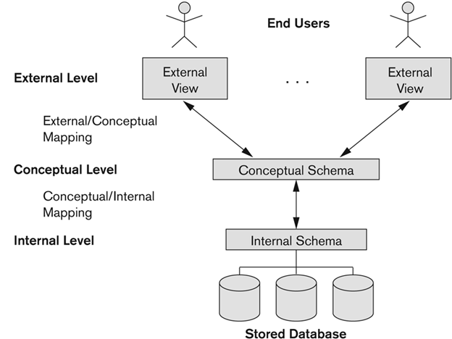
CSE, KL University

Slide 3
Logical Data Independence:
  The capacity to change the conceptual schema without having to change the external schemas and their associated application programs.
Physical Data Independence:
  The capacity to change the internal schema without having to change the conceptual schema.
CSE, KL University

Slide 4
Data Definition Language (DDL)
  It is used to create schema, tables, indexes, constraints, etc. in the database.
    Create, Alter, Drop, Truncate, Rename, etc..
Data Manipulation Language (DML)
  for accessing and manipulating data
    Select, Insert, Update, Delete, Merge, Lock Table, etc..
Data Control Language (DCL)
  used to retrieve the stored or saved data
    Grant, revoke
Transaction Control Language (TCL)
  used to run the changes made by the DML statement
    Commit, Rollback
CSE, KL University

Slide 5
  Menu-based
  Form-Based
  Graphical User Interface
  Natural language Interface
  Speech Input and Output
  Interfaces for Parametric users
  Interfaces for DBA
CSE, KL University

Slide 6
Data Model:
  A set of concepts to describe the structure of a database, the operations for manipulating these structures, and certain constraints that the database should obey.
  Data Models provides the necessary means to achieve data abstraction.

Slide 7
Conceptual (high-level, semantic) data models:
  Provide concepts that are close to the way many users perceive data. (WHAT the system contains)
    Also called entity-based or object-based data models.
    useful to understand the needs or requirements of the database.
Implementation (representational) data models:
  Provide concepts that fall in between high and low level, used by many commercial DBMS implementations
    e.g. relational data models, hierarchal or network models
    represent only the logical part of the database
    focuses on the design part of the database.
Physical (low-level, internal) data models:
  Provide concepts that describe details of how data is stored in the computer. These are usually specified in an ad-hoc manner through DBMS design and administration manuals

